Slide 1
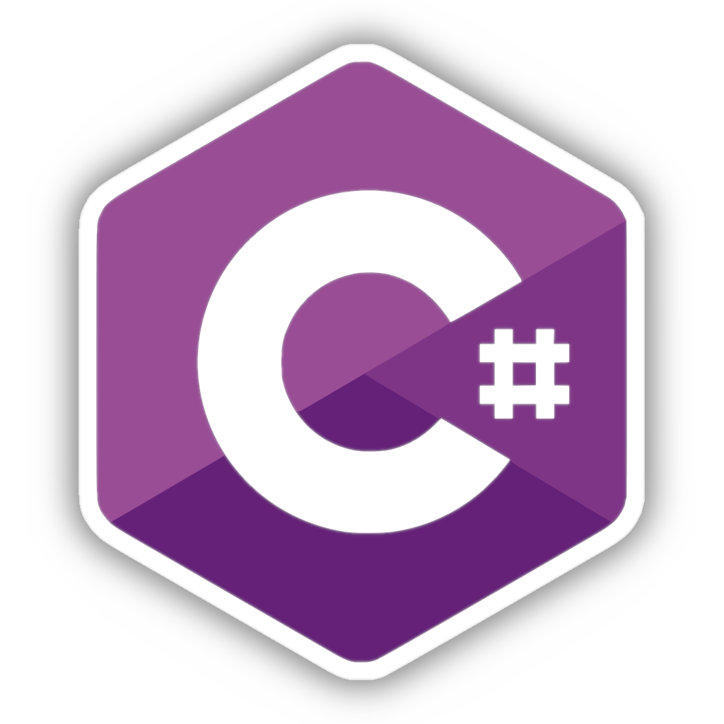
MULTITHREADING

Slide 2
What Is Thread?
Thread
Console.WriteLine(“Print Something”);
int i = 10;
i = i + 1;
i = i + 2;
Console.WriteLine($”Current value i = {i}”);
i *= 10;
…
Thread of execution is the smallest sequence of programmed instructions that can be managed independently by a scheduler, which is typically a part of the operating system.

Slide 3
Threads vs. Processes
Process
Thread 1
Thread 2
Thread 3
Thread N
...

